Slide 1
GraphQL

Slide 2
Introduction
Why GraphQL.
What is GraphQL.
Who is using GraphQL.
Demo
Schema
Queries
Errors
Mutations
Authentications

Slide 3
Introduction

Slide 4
Why GraphQL?

Slide 5
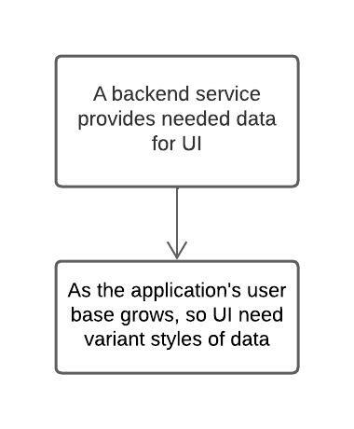
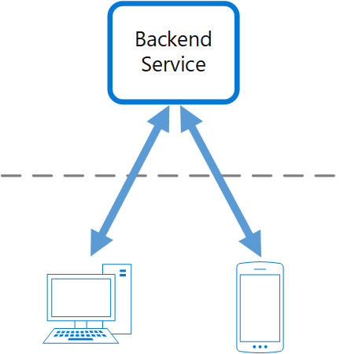
Backend For Frontend (BFF)
Problems
=> Backend becomes bottleneck in development process, spending a lot of effort on a single deployable resource

Slide 6
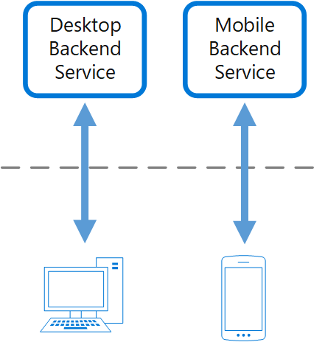
Backend For Frontend (BFF)
Solution
Create once backend per UI.
Fine-tune the behavior and performance of each backend to best match the needs of the frontend environment, without worrying about affecting other frontend experiences.
Each interface team control their own backend.
Give team flexibility to choose language, release candence, tools,...

Slide 7
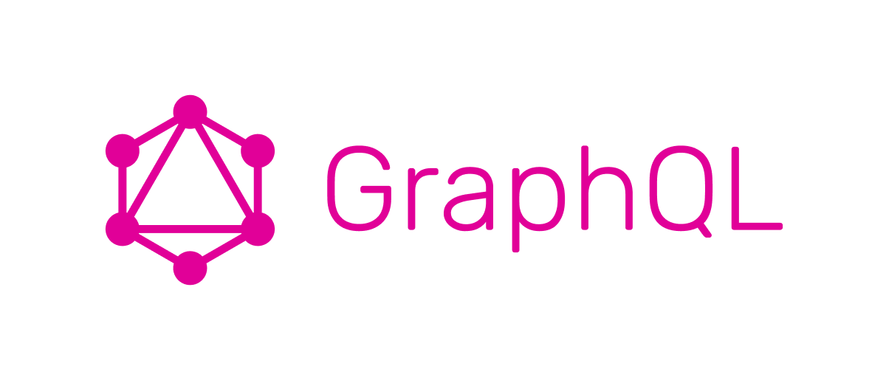
Backend For Frontend (BFF)
Disadvantage
Duplication features/code acorss services.
Create complexities for backend team.
Responsibilities of a development team.
Are we going to use microservices here? => Bring all drawbacks of MSA too.
Is there any solutions that can be a single backend for multiple UI?

Slide 8
What is GraphQL?
Open-sourced by Facebook.
A query language for your API.
Ask for what you need; get exactly that.
Get many resources in a single request.
Describe what’s possible with a type system.
Move faster with powerful developer tools.
Evolve your API without versions.
Bring your data and code.

Slide 9
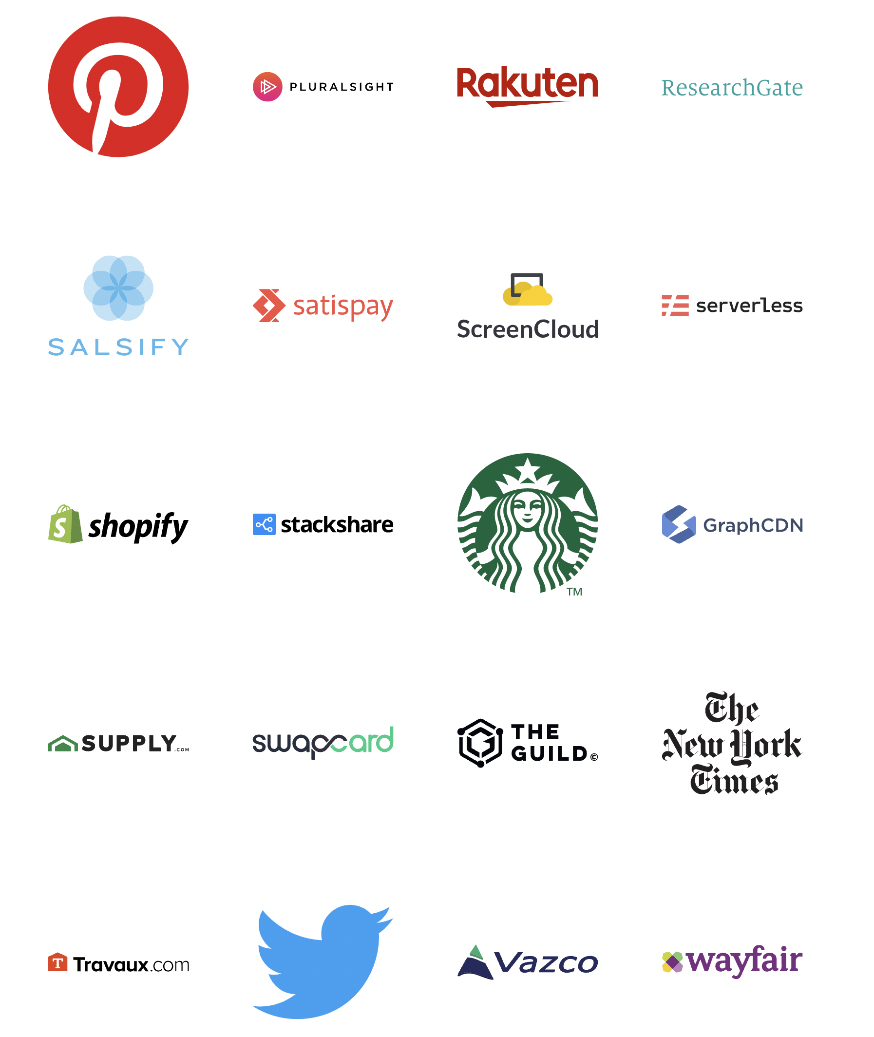
Who is using GraphQL?

Slide 10
01
Schema

Slide 11
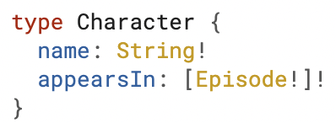
What is schema?
A GraphQL schema is a description of the data clients can request from a GraphQL API
Basic Type:
String
Int
ID
Float
Boolean
[Basic Type] => Array with basic type (eg: [String], [Int],...)
Non-null:
Exclamation mark - Type! (eg: String!, Int!,...)
Character is a GraphQL Object Type
name and appearsIn are fields
name has type string and non-null
appearsIn has type array of Episode and non-null array, also cannot contain null element

Slide 12
02
Queries

Slide 13
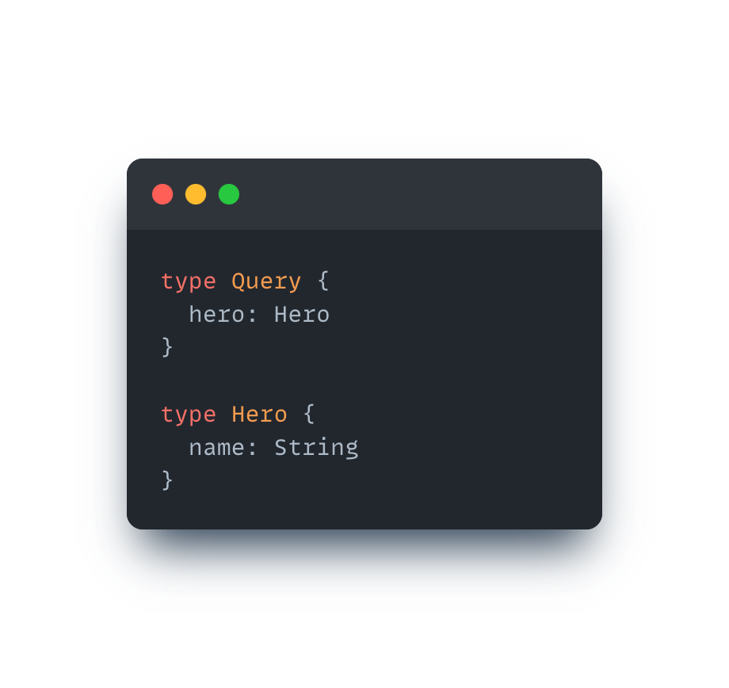
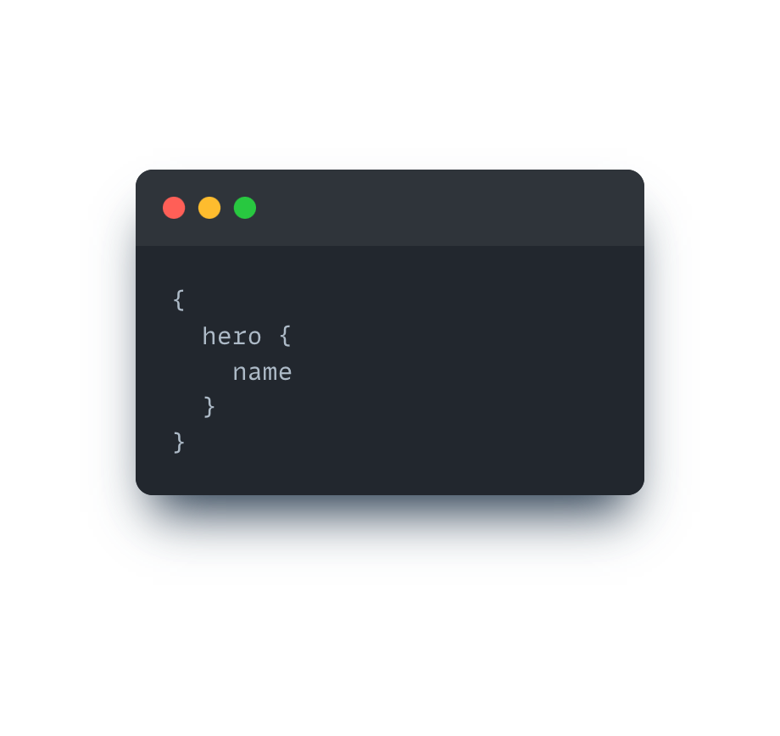
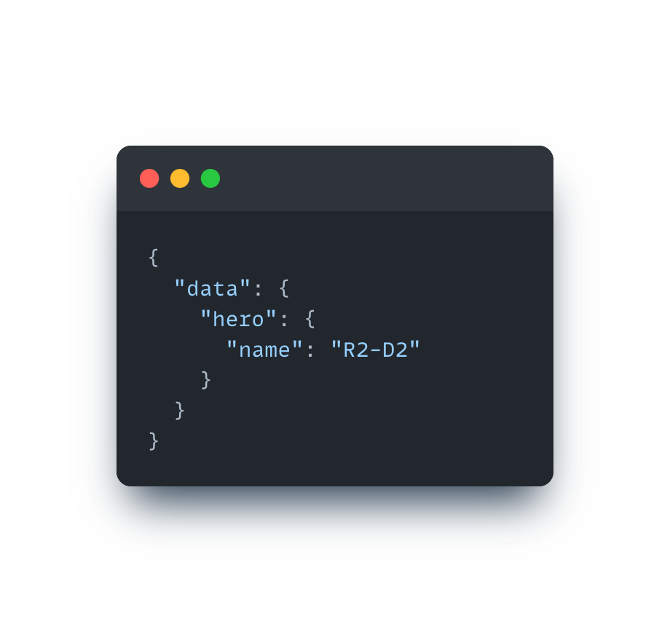
What is query?
A query is used to read/fetch data
How to declare a query?
How to use a query?
Example response

Slide 14
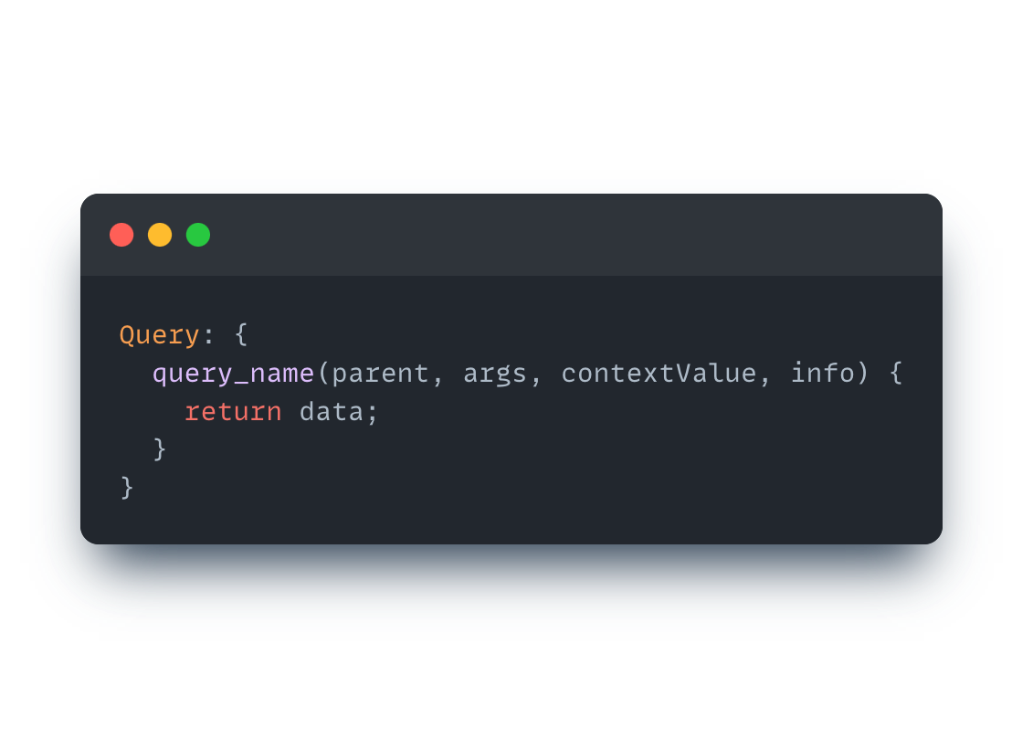
What is resolver?
A resolver is used to resolve query
How to declare a resolver?
parent: The return value of the resolver for this field's parent
args: An object that contains all GraphQL arguments provided for this field.
contextValue: An object shared across all resolvers that are executing for a particular operation.
info: Contains information about the operation's execution state

Slide 15
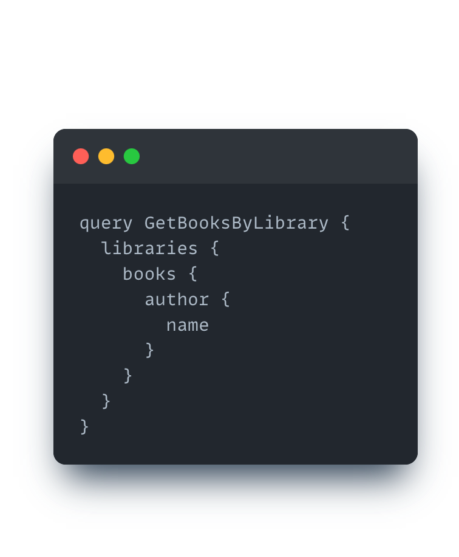
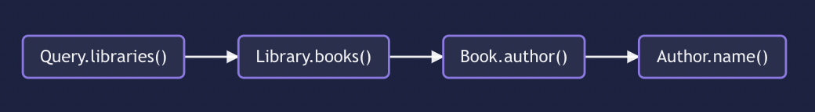
How do resolver resolve query?
The resolver function resolves query field by field - like DFS (depth first search algorithm)
Example query
Resolve chains

Slide 16
03
Mutations

Slide 17
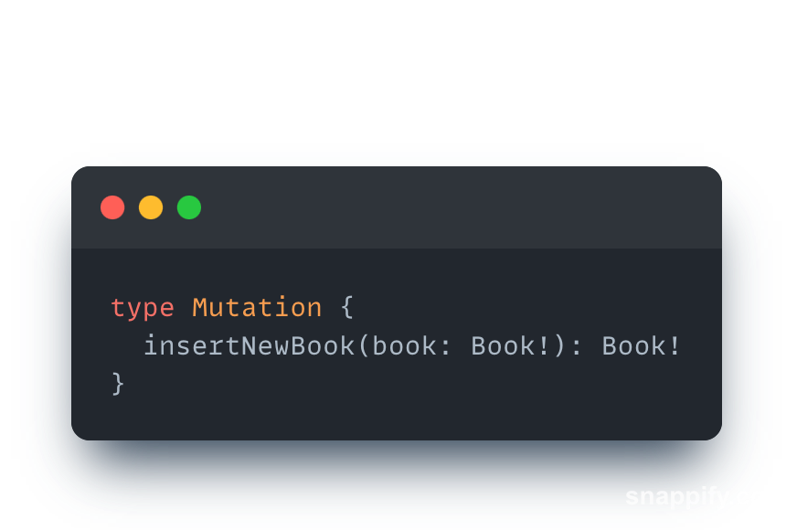
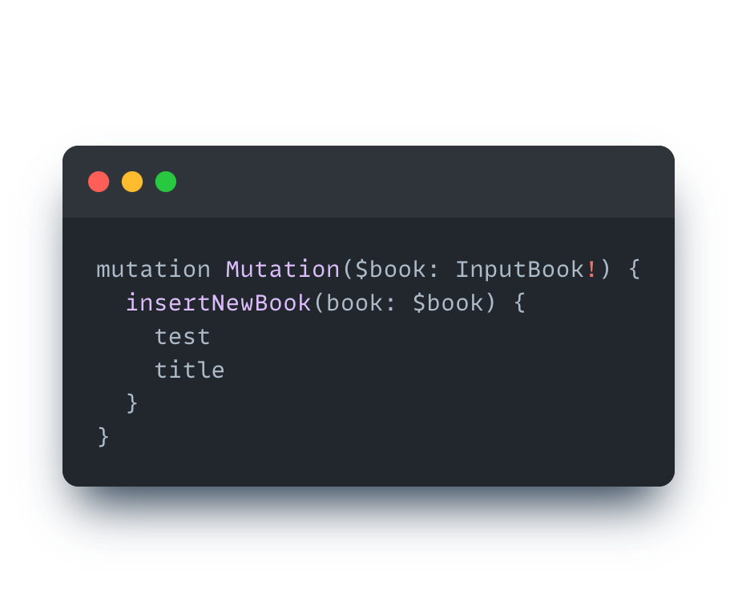
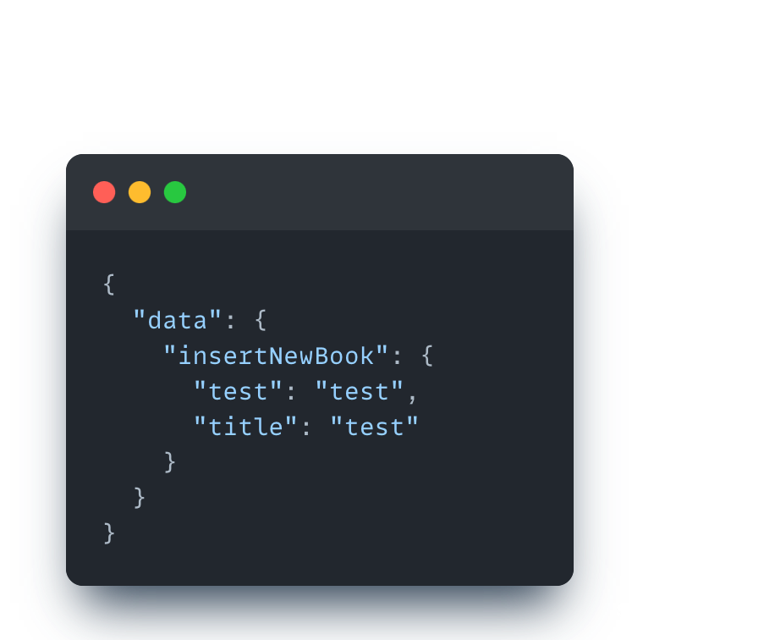
What is mutation?
A mutation is used to mutate data
How to declare a mutation?
How to use a mutation?
Example response

Slide 18
04
Subscriptions

Slide 19
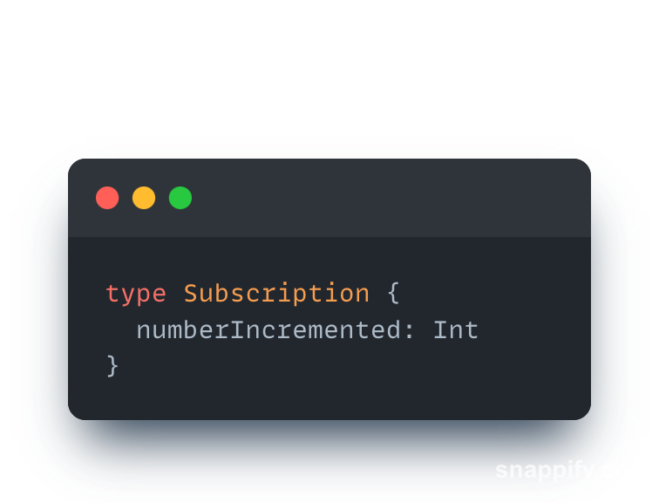
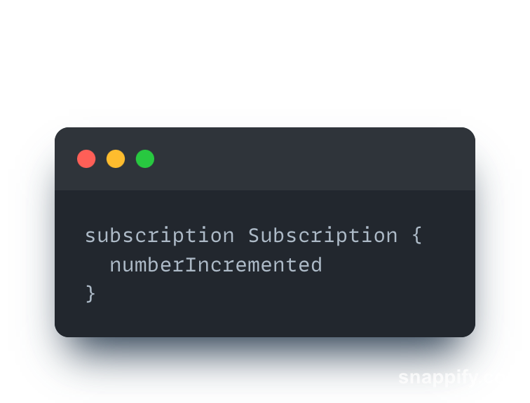
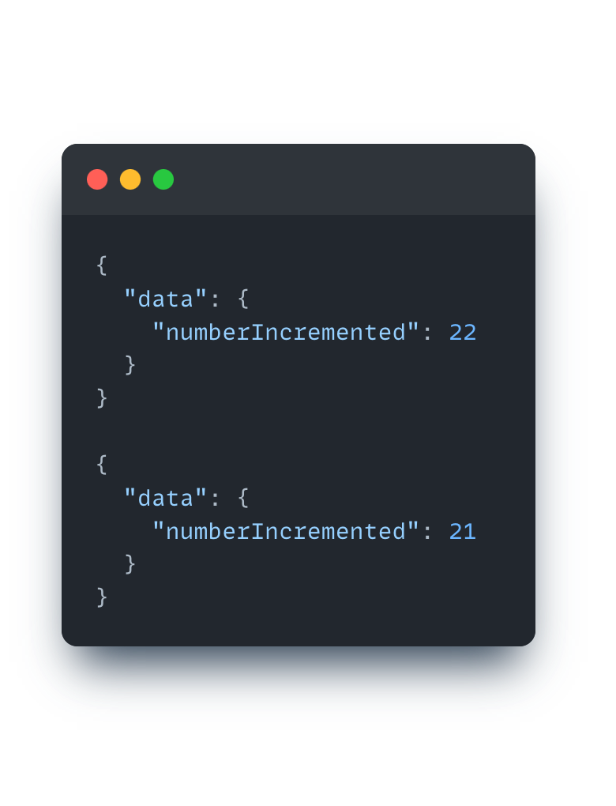
What is subscriptions?
A subscriptions are a feature that allows server to send data to its client when a specific event happends
How to declare a subscriptions?
How to use a subscriptions?
Example resposne

Slide 20
05
Errors

Slide 21
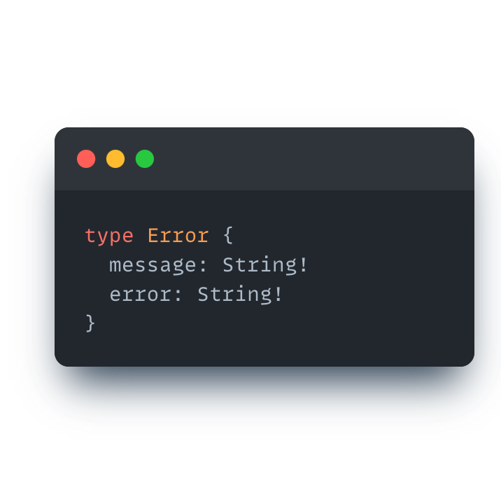
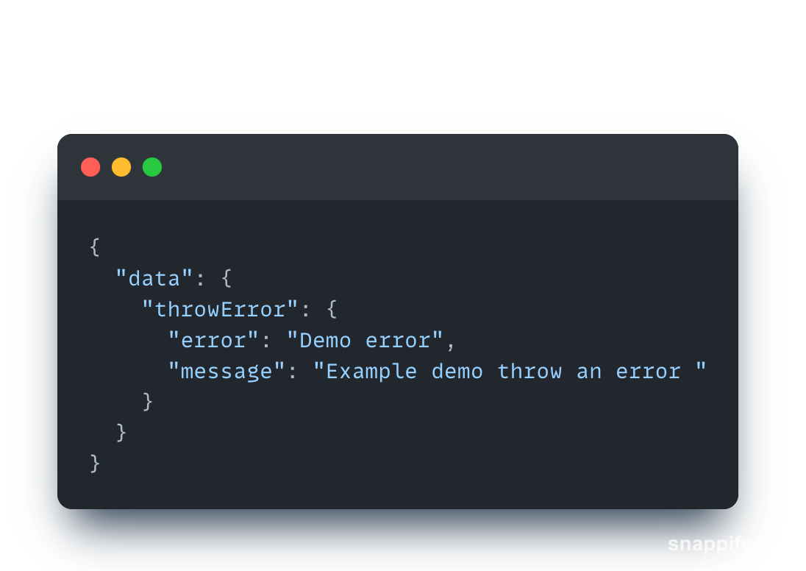
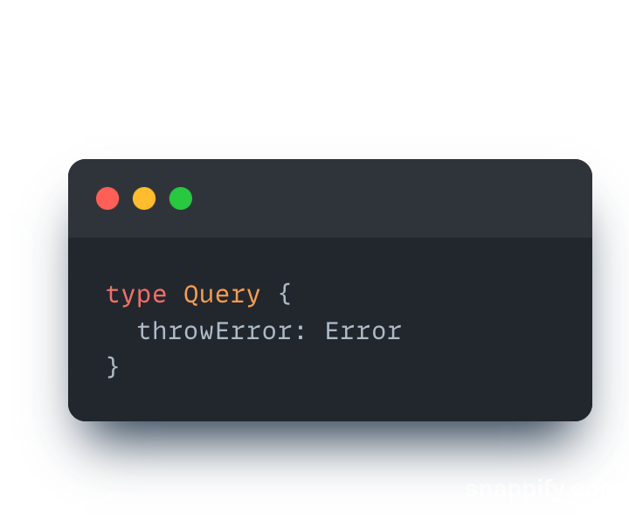
Errors
In Graphql, we don't have a standard way to return errors to the clients. Because of this reason we need to define errors for ourself
How to handle an error?
Example resposne

Slide 22
06
Typescript in Graphql

Slide 23
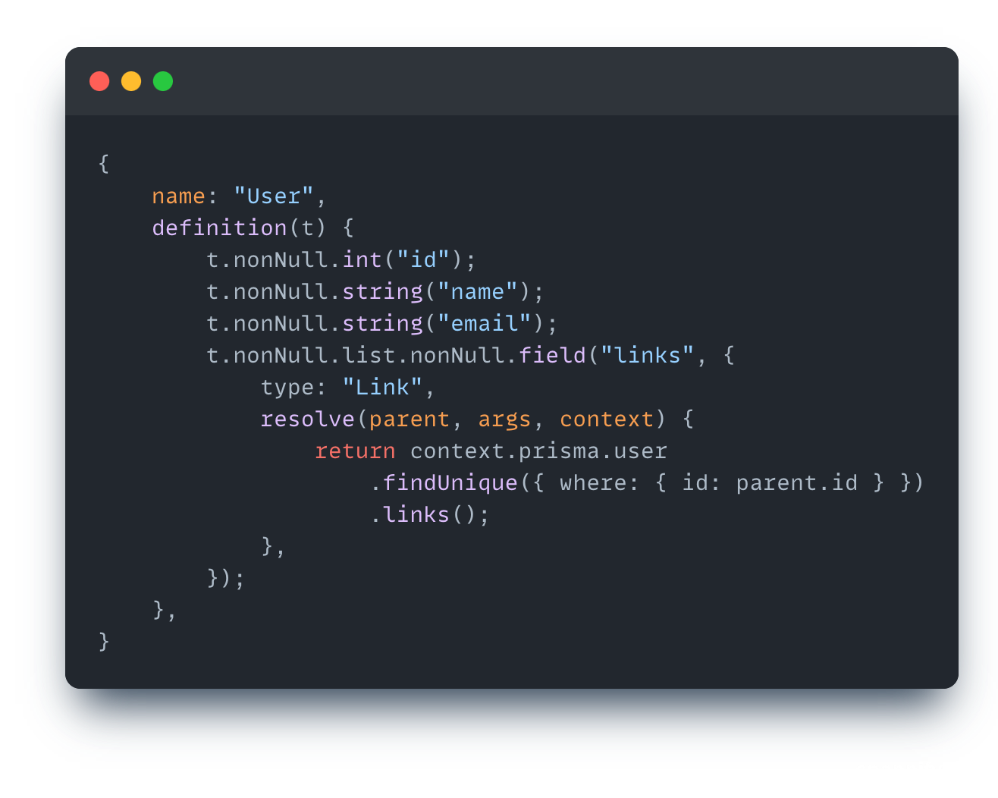
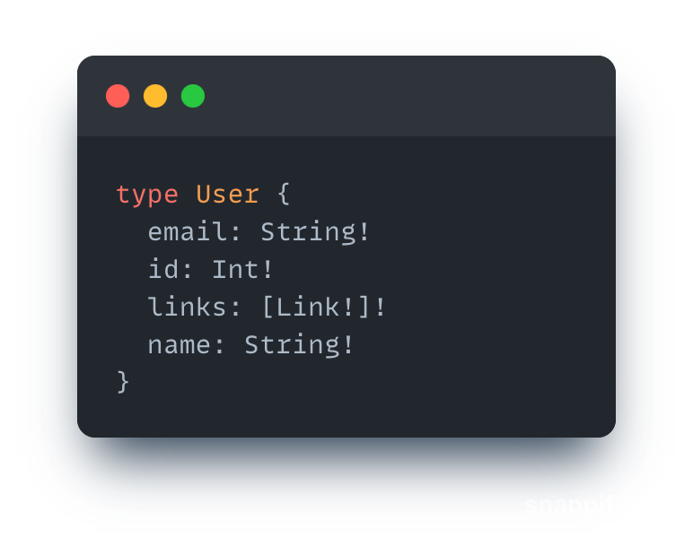
Code first
Code first means we don't need to write any schema code, we write Typescript code to generate schema and type files
Write typescript code
Generated schema

Slide 24
Code first
Advantages:
Don’t need to write schema
Don't need to write typescript that maps schema file
Can't split service and schema file
Disadvantage:
Eventually, we need to work with schema file
Generate complicated typescript files, it is hard to read and reuse
There are no any solutions for federation.

Slide 25
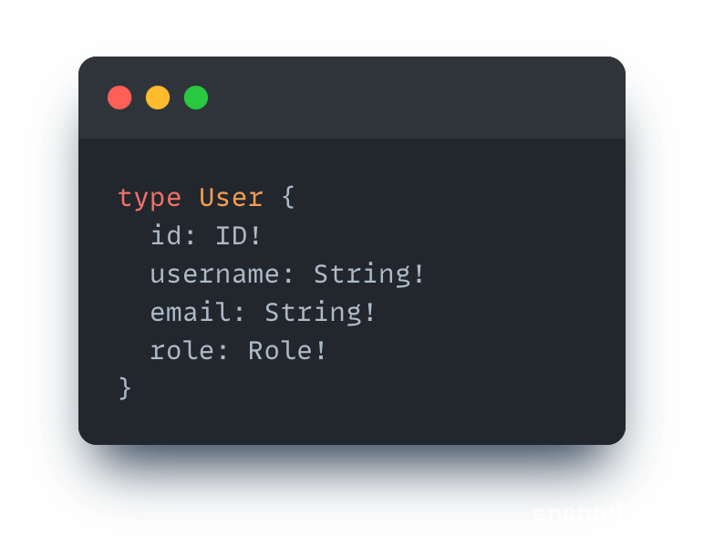
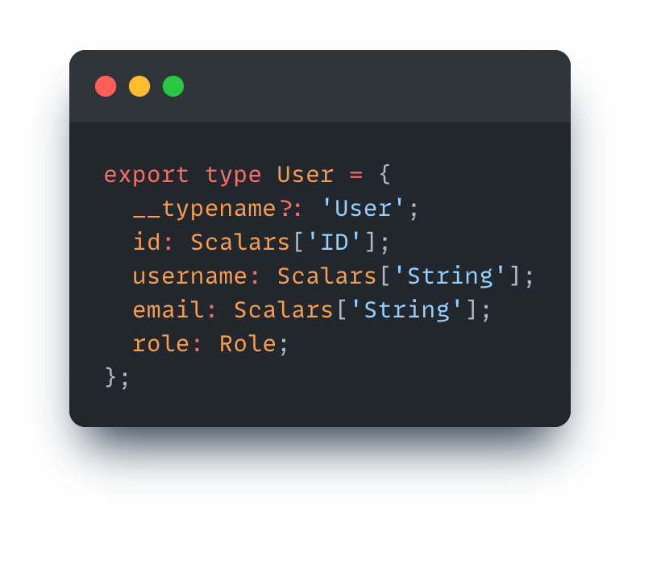
Schema first
We write schema in graphql, then using tools generate typescript mapping with schema file
Write schema
Generated typescript

Slide 26
Schema first
Advantages:
Resolve problems when we deal with code first approach
Disadvantage:
Typescript file is generated by third-party, so we can't control and take advantage of it

Slide 27
05
Pros & Cons

Slide 28
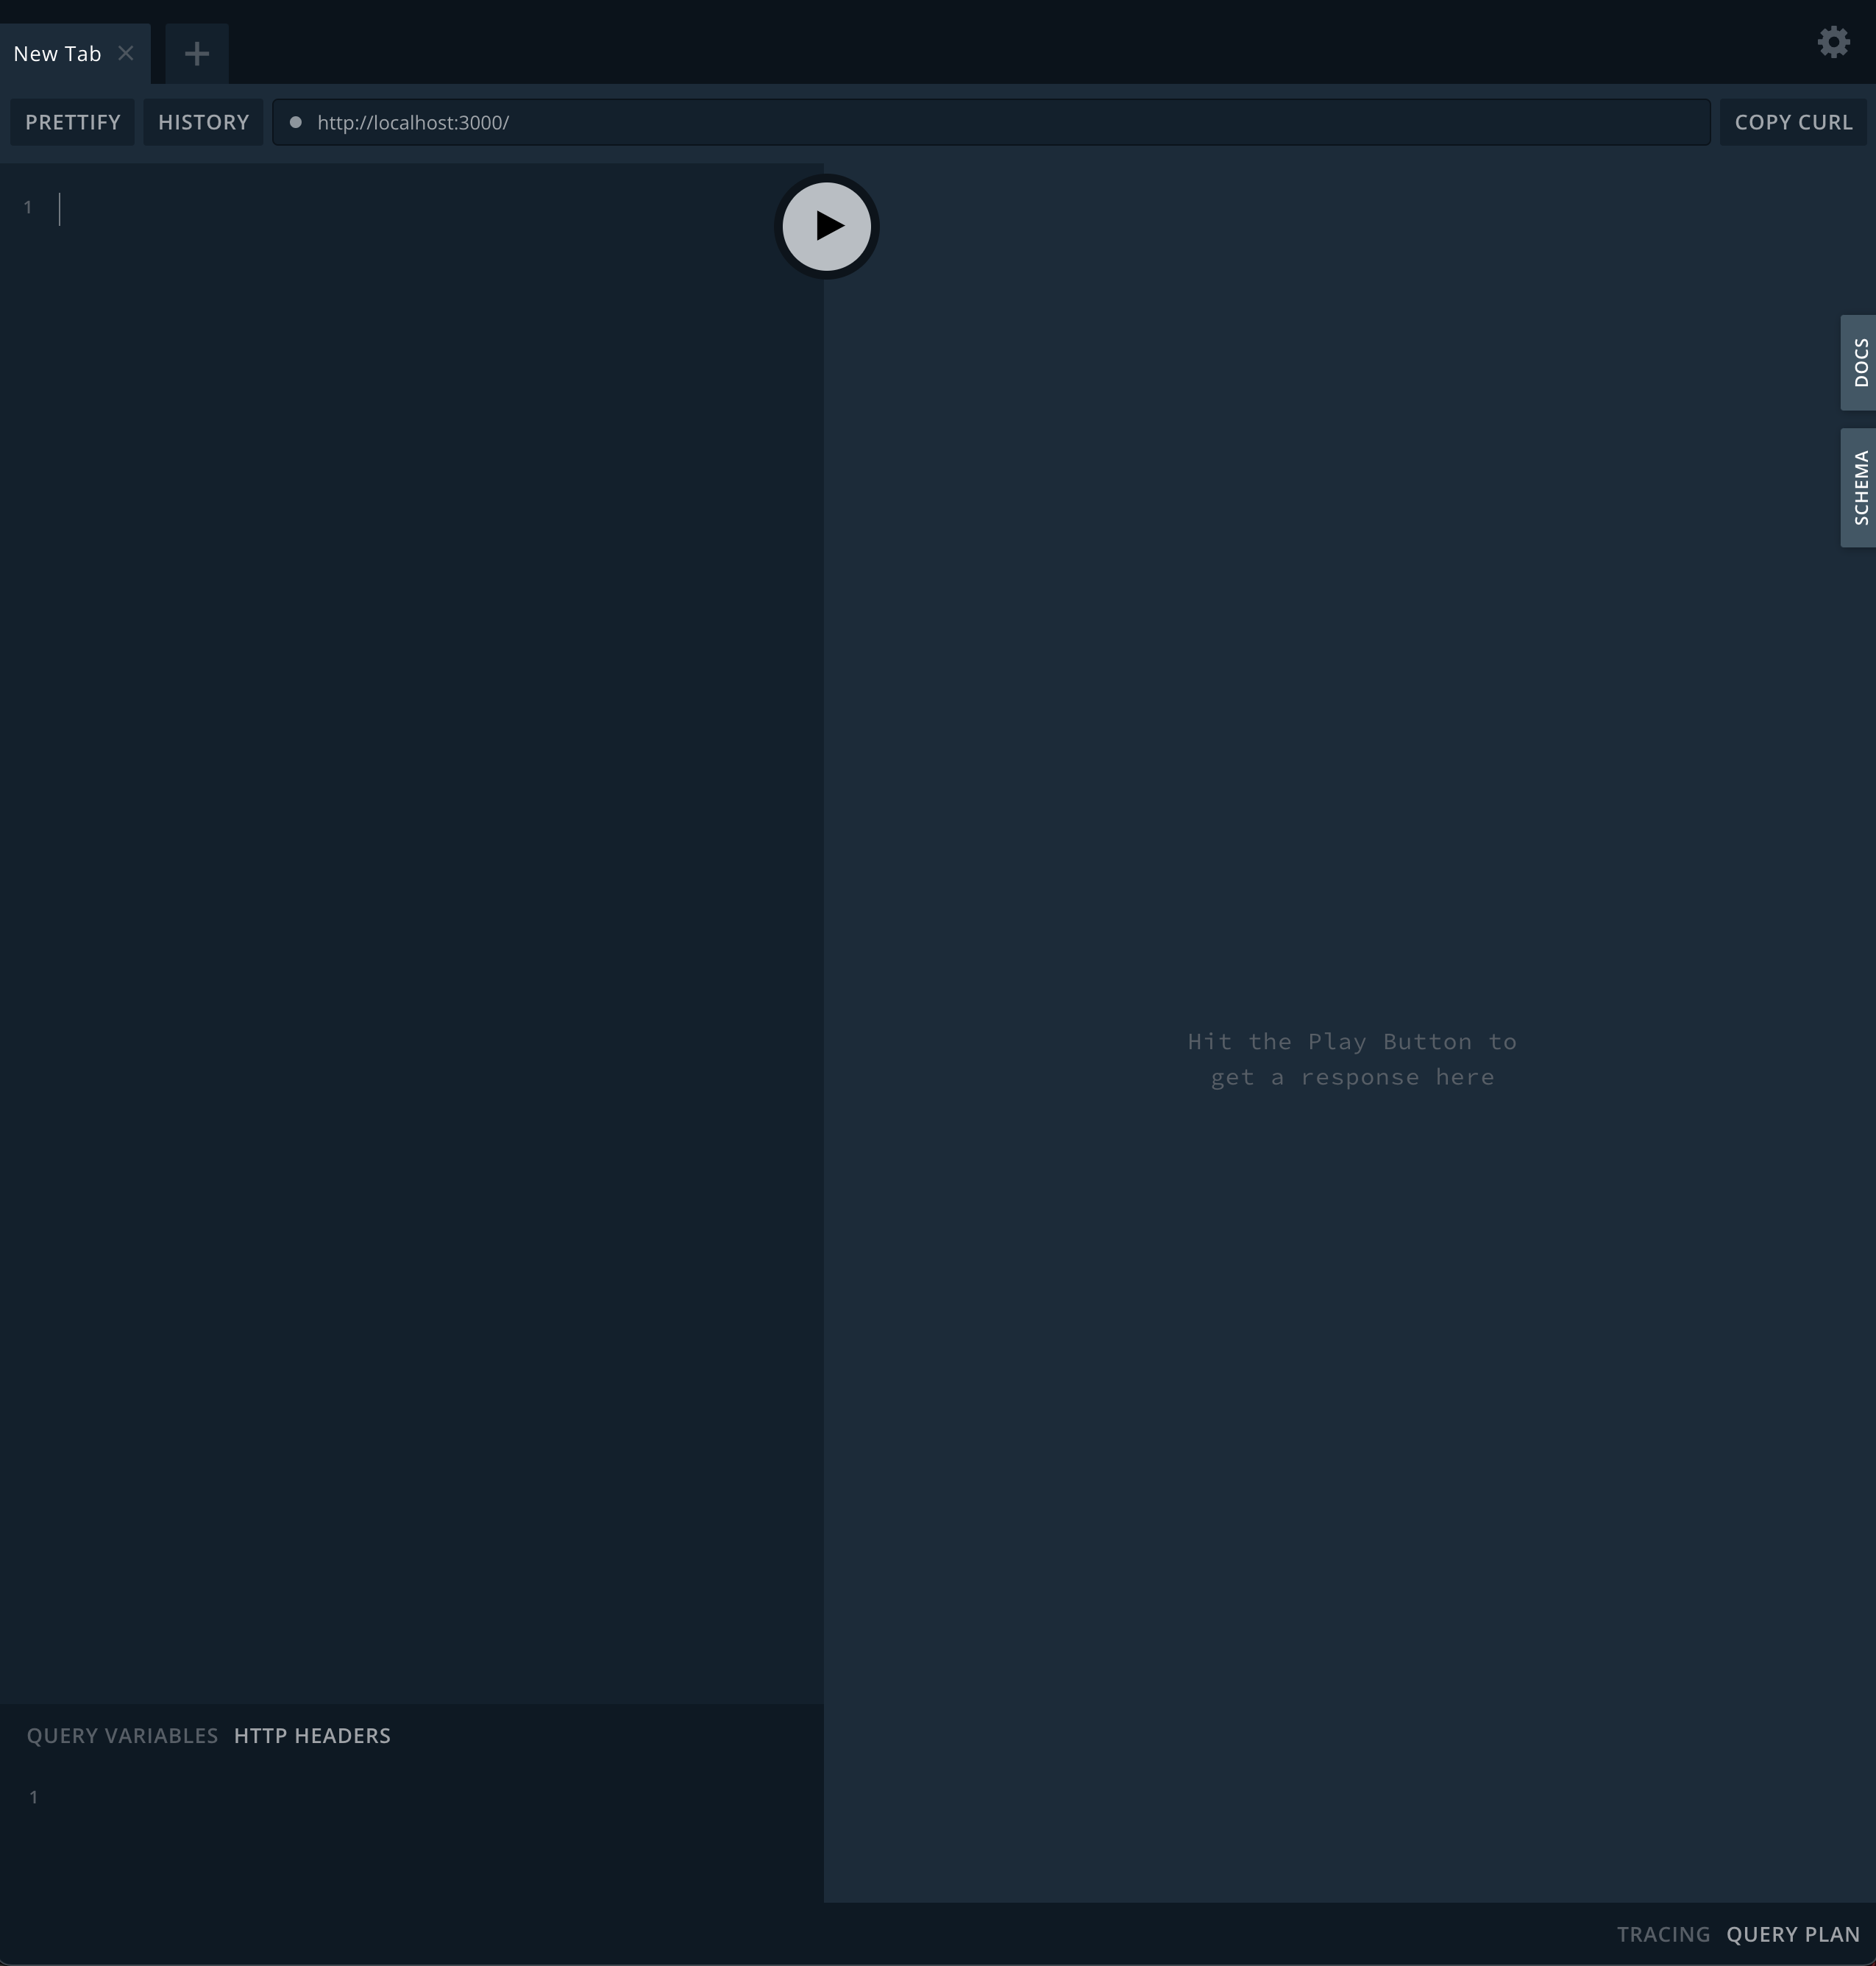
Graphql playground - Pros
We have built-in playground as documentation

Slide 29
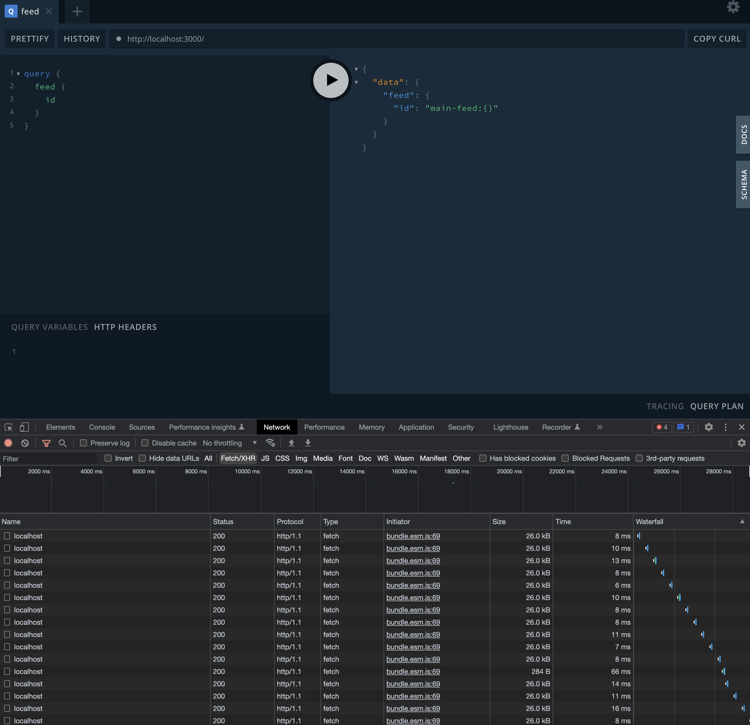
Graphql playground - Cons
Network with chrome is painful - it is hard to find what you are looking for, as all the endpoints look the same (need to inspect detail of network)

Slide 30
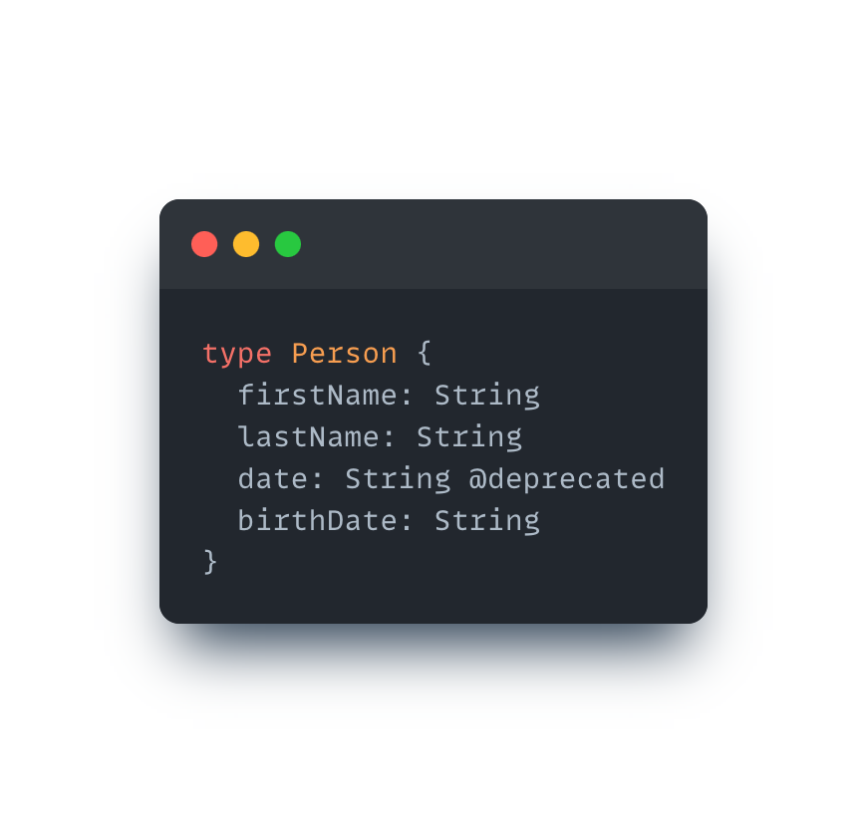
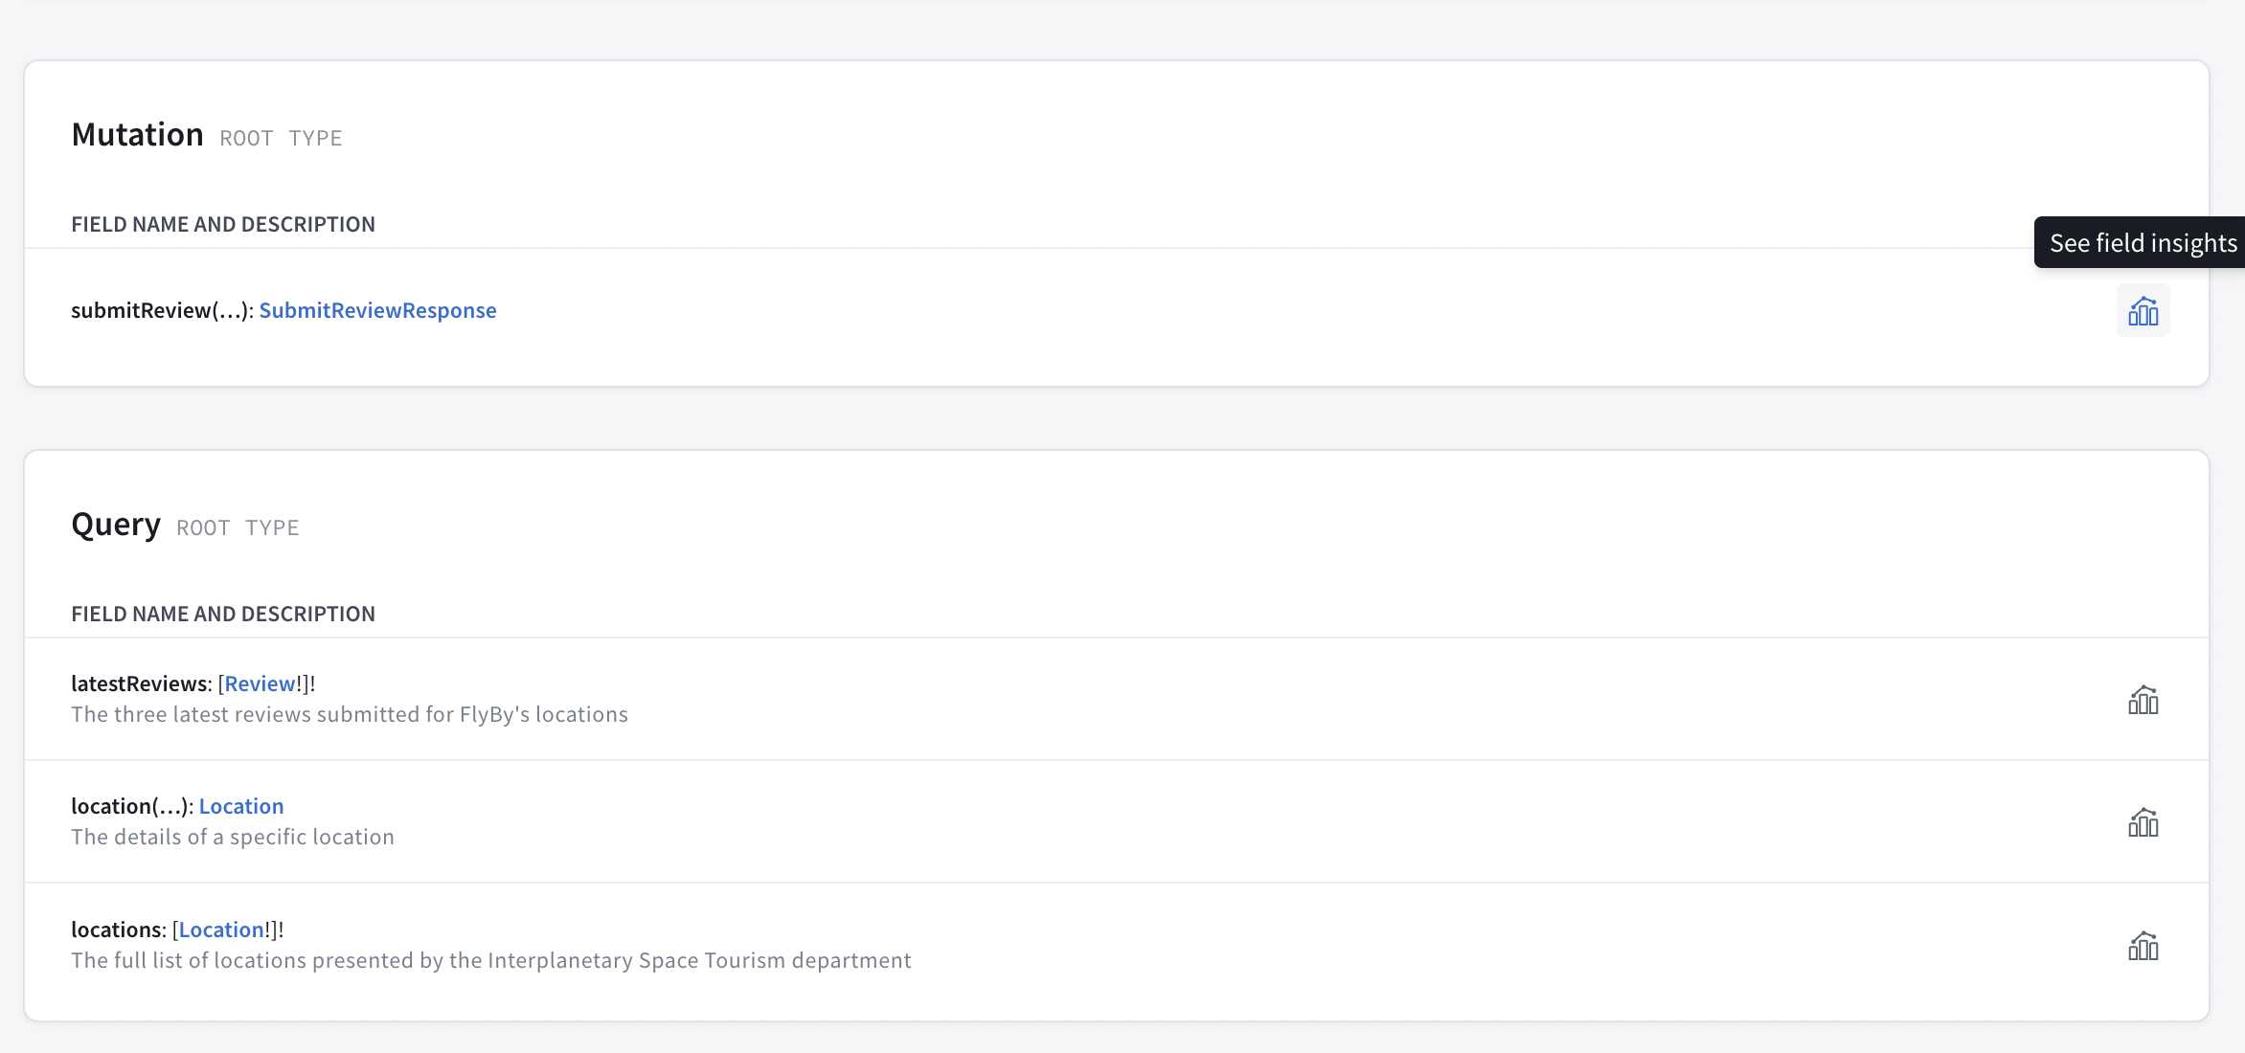
Version free
Nothing is free. How can we adjust for backward compatibility?
Version GraphQL as Rest - not recommend
Using annotation to mark new/old fields, then monitor it

